Slide 1
Exposing .NET and JIT for profit
Khristopher Tolbert
[Title, Date, maybe (Maveris/Halfaker/VA etc]

Slide 2

Who?
Khristopher Tolbert, CISSP, OCSP, alphabet soup
Offensive Security or related field since 2005
USMC Information Assurance Red Team Member (Contractor) 2006-2010
DoD, USMC, Mantech Cyber Range Red Cell Member/Lead (Contractor) 2010-2018
VA CSOC EAS Red Team Member (Contractor) 2018-
B.S. in I.T –Network Security Focus, WGU 2012
Don’t we all? (sorry for the bad joke)
@khr0x40sh on Twitter, Github
Yes, that avatar is my actual dog at 4 months old. He’s 12 now and still trying to run in the middle of the street when I open my front door :-/ (still a good boy tho)

Slide 3
What?
C# (.NET) and how to de-compile it into human readable source
Surprisingly not that difficult
C#, part 2: powershell can do it too!
Using powershell to load C# assemblies/source:
Assembly::Load()
Add-Type
C#, part 3: Just in Time Hooking
De-compiling
Debugging
DEMO if we have time
Thanks DerbyCon!

Slide 4
Why?
Malware is cyclic
What’s old is new
VBA based malware, then C#, then powershell, back to C# …?
JIT hooking code has been around for awhile, but now seems to be getting adopted for .NET malware
JIT hooking may make decompiling troublesome as well
.NET Framework is everywhere
Big target
Embedded, may be invisible to older defenses
Techniques for debugging may be used across numerous other .NET Languages (powershell, C#, etc…)
Interesting enough, anyone can make a .NET language
http://www.irongeek.com/i.php?page=videos/derbycon9/1-17-red-team-level-over-9000-fusing-the-powah-of-net-with-a-scripting-language-of-your-choosing-introducing-byoi-bring-your-own-interpreter-payloads-marcello-salvati

Slide 5
C# decompiling
Typically binaries when compiled, are very difficult to reverse back into source code
Tools do exist for this (HexRays, for example) but even the output is slightly off
C#, however, because it is a managed assembly, isn’t
This is thanks to the Common Language Runtime of the .NET Framework
A bit beyond this class, go here for more information: https://docs.microsoft.com/en-us/dotnet/standard/managed-code
Also, Just in Time compiling = Converts Intermediary Language into Machine Code for execution. This is done at Runtime via the .NET Framework (https://stackoverflow.com/questions/5589409/c-sharp-jit-compiling-and-net)

Slide 6
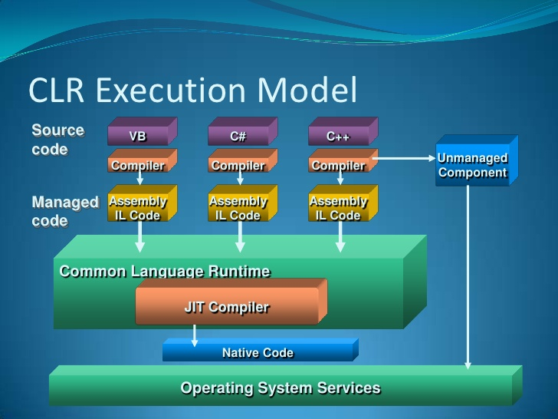
C# decompiling
http://www.slideshare.net/ArunPrasadVidhyaarthi/introduction-to-net-framework

Slide 7
C# decompiling
Some nifty tools out there exist for returning managed assemblies back to source:
iLSpy
https://github.com/icsharpcode/ILSpy
Open Source
Supports more than C#, but decompiles back to C#
dnSpy
https://github.com/0xd4d/dnSpy
Open Source
Uses the iLSpy libraries for decompiling!
Can debug and edit managed assembly on the fly!
Support for C# and VB.NET

Slide 8
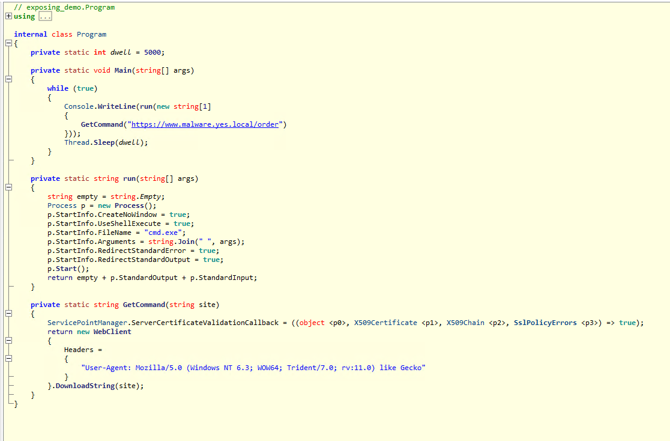
C# Decompiling – iLSpy Demo

Slide 9
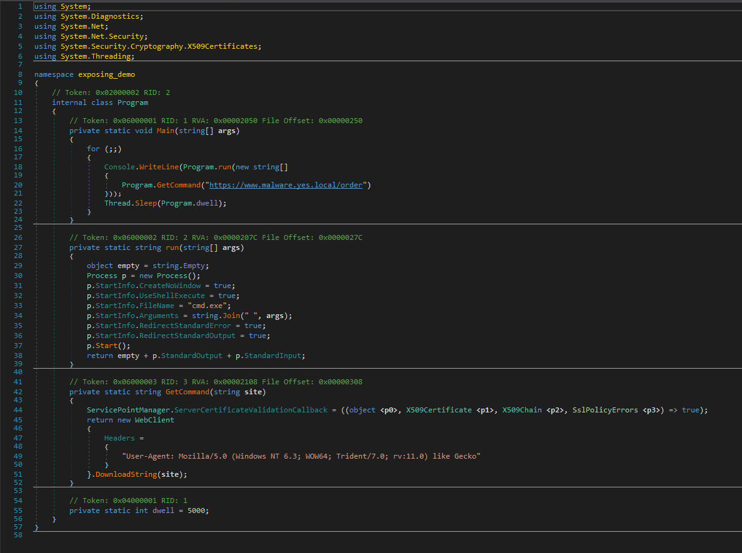
C# Decompiling – dnSpy Demo

Slide 10
C# part 2: powershell can do it too!
Due to the increasing security efforts on powershell, malware authors and researchers are moving to other .NET languages
Thanks AMSI
Anti-Malware Scan Interface
https://docs.microsoft.com/en-us/windows/win32/amsi/antimalware-scan-interface-portal
No AMSI of .NET 4.7 or lower, but is coming for 4.8
Powershell can still be used as the initial access to load in other .NET assemblies
Can execute .NET assemblies in memory
Compile the source via .NET so as to run in memory

Slide 11
C# part 2: powershell can do it too!
Assembly::Load()
Read in a managed executable as a byte array
Call Assembly::Load(byte array)
PROFIT?
Indicators:
Large arrays of data in powershell script or one-liner
Base64 is the usual encoding, but other ways have been seen/exist
This may also be staged, so the one liner will look to grab the blob from another location, such as a webserver
This is seen by these threat actors or malware:
DEEP PANDA (2014)
MadHatter
Oilrig
ReflectivePrick
https://www.endgame.com/blog/technical-blog/hunting-memory-net-attacks
Defensive measures?
Constrained Language (Powershell 5.0)
Logging and review/ingest of such
Others may exist?

Slide 12
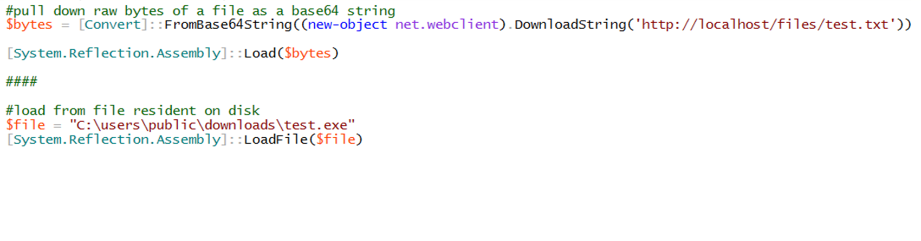
C# part 2: powershell can do it too!
Assembly::Load() DEMO

Slide 13
C# part 2: powershell can do it too!
Add-Type –TypeDefinition $source
Read in source code
Call Add-Type –TypeDefinition $source
Call exposed function of source, such as Program.Main
[Namespace.Class]::function($variable)
Indicators:
Large arrays of data in powershell script or one-liner
Base64 is the usual encoding, but other ways have been seen/exist
This may also be staged, so the one liner will look to grab the blob from another location, such as a webserver
Temporary *.cs in user’s %TEMP% folder
Csc.exe executed under the context of powershell.exe
https://blog.didierstevens.com/2019/10/15/powershell-add-type-csc-exe/
Event IDs 600 Powershell Log, 4103 in PowerShell (Microsoft-Windows-PowerShell)
This is seen by these threat actors or malware:
APT32
Others with powershell tagged to them
https://www.fireeye.com/blog/threat-research/2018/07/malicious-powershell-detection-via-machine-learning.html
Defensive measures?
Constrained Language (Powershell 5.0)
Logging and review/ingest of such
Others may exist?

Slide 14
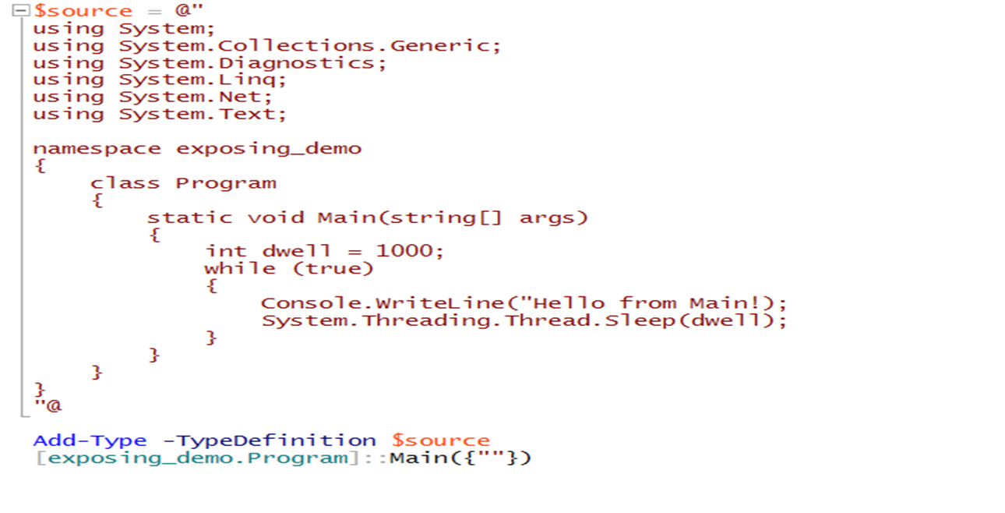
C# part 2: powershell can do it too!
Add-Type –TypeDefinition $source DEMO

Slide 15
C# part 2: powershell can do it too!
In a full circle, C# can also execute powershell without calling powershell.exe
Uses System.Management.Automation.dll
May evade detection of signatures looking for powershell processes
Architecture (x86/x64) has to match or powershell.exe will spawn!
Indicators:
Use of System.Management.Automation.dll
This is seen by these threat actors or malware/tools:
Cobalt Strike
Numerous that use the PowerPick style powershell execution
Slingshot
Muddy Water APT
https://securelist.com/muddywaters-arsenal/90659/
Defensive measures?
Logging and review/ingest of such
Others may exist?
Maybe AMSI in .NET 4.8

Slide 16
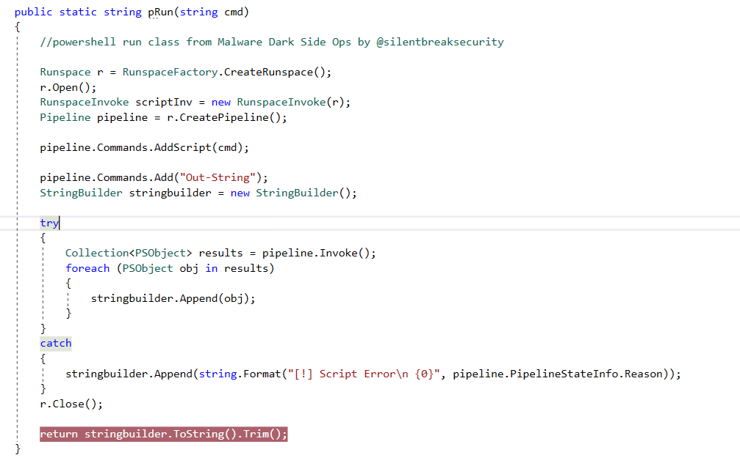
C# part 2: powershell can do it too!
System.Management.Automation.dll DEMO

Slide 17
C#, part 3: JIT Hooking
Just in Time Hooking
Method used to compile sections of code at runtime
Accomplished in .NET by swapping out the VTable of the compiledMethod with our code
Explained a bit better here:
https://ubbecode.wordpress.com/tag/jit-hook/
Used as a means to store strings or methods in a manner that is not detectable by static de-compilers
May be increasingly more difficult to unravel what the code is doing
Indicators
Code that executes something else than what is in the source
Use of known Hooking DLLs
SJiTHook, etc.
This is seen by these threat actors or malware:
Common with other languages (C, C++), most likely does exist with C#
Defensive measures?
AMSI in .NET 4.8? Maybe?
Behavioral Signatures on Assemblies?

Slide 18
C#, part 3: JIT Hooking – de-compiling?
Easy Stuff first
Load assembly in dnSpy
Observe the execution chain
Make note the Hook routine
In our example using SJITHook, it is HookCompileMethod
Insert breakpoint on hooked method
Execute (in lab if dealing with malware) up to breakpoint
Observe code changes as you step through the hook
The example in the demo will overwrite a specifically named method to swap out code base with an encrypted array
Something like this is common with JIT hooked methods in malware to obfuscate strings
Get lucky and identify a point you can break on to extract the encrypted/obfuscated strings.
Right-click and choose “Go to disassembly”

Slide 19
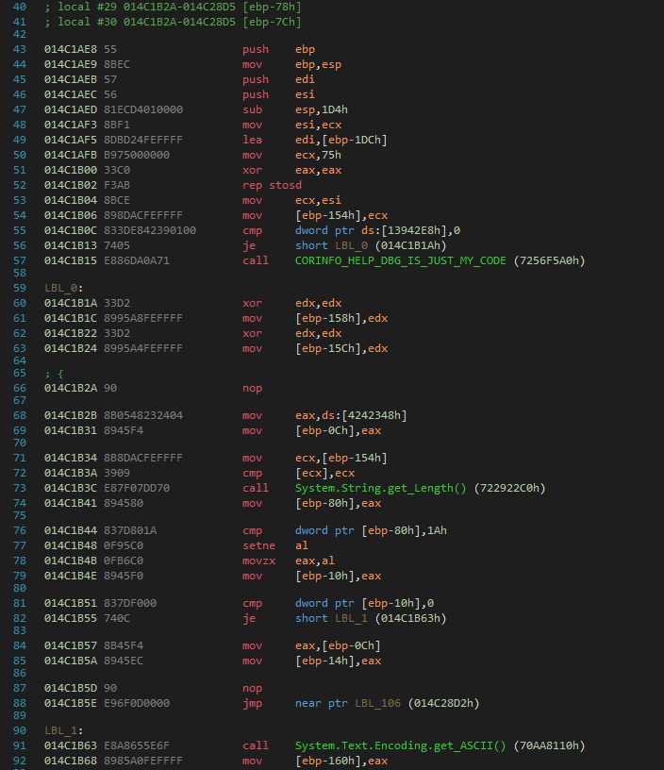
C#, part 3: JIT Hooking – de-compiling?

Slide 20
C#, part 3: JIT Hooking – debugging?
What if I want to debug this?
Attach to assembly in windbg
Set up windbg for use with .NET assemblies
May cause a headache or two as windbg sometimes will not catch specified breakpoints
sxe ld:clr
g
!sym noisy
.cordll –ve –u –l
.loadby sos clr
Add breakpoints (!bpmd binary_name.exe Class.method)
Cross fingers, and g
Attempt to break on Hooked method
In our example, it is get_flag
Execute (in lab if dealing with malware) up to breakpoint
Observe code changes as you step through the hooked method
Shameless blog plug about these steps: https://khr0x40sh.wordpress.com/2019/09/12/derbycon-ctf-net-mssql-shenanigans/

Slide 21
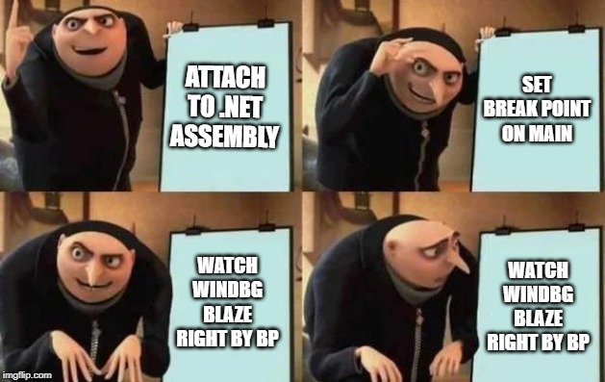
C#, part 3: JIT Hooking – DEMO
A sample from DerbyCon’s CTF!

Slide 22
Special Thanks
DefaultUser (DerbyCon CTF Team)
Rudy
Allen
Maveris, LLC
Halfaker
@DerbyConCTF
@SilentBreakSecurity
@byt3bl33der
The authors of the links in these slides
And you for coming to my talk!

Slide 23
References
https://docs.microsoft.com/en-us/dotnet/standard/managed-code
https://stackoverflow.com/questions/5589409/c-sharp-jit-compiling-and-net
https://github.com/icsharpcode/ILSpy
https://github.com/0xd4d/dnSpy
https://www.endgame.com/blog/technical-blog/hunting-memory-net-attacks
https://www.fireeye.com/blog/threat-research/2018/07/malicious-powershell-detection-via-machine-learning.html
https://ubbecode.wordpress.com/tag/jit-hook/
https://securelist.com/muddywaters-arsenal/90659/
https://docs.microsoft.com/en-us/windows-hardware/drivers/debugger/debugging-managed-code
https://blog.didierstevens.com/2019/10/15/powershell-add-type-csc-exe/
https://blog.talosintelligence.com/2017/07/unravelling-net-with-help-of-windbg.html
https://theartofdev.com/windbg-cheat-sheet/

